Slide 1
BHARTI INFOTECH AND SERVICES
Bilaspur , Chhattisgarh
Introduction to LCD Screen

Slide 2
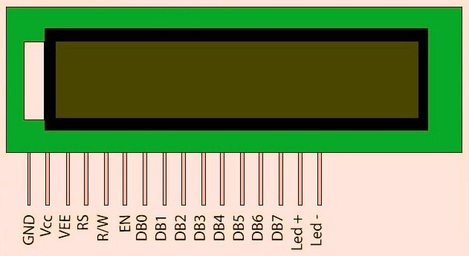
Interfacing LCD with Arduino Uno
16×2 character LCD display is a very basic LCD module which is commonly used in electronic projects. 16×2 means it can display 2 rows of 16 characters (columns). Its other variants such as 16×1, 16×4 etc are also available. These LCDs are usually made using HD44870 compatible controllers. In this tutorial we will see how to interface a 16×2 Character LCD display with Arduino UNO development board. Arduino provides built in libraries for interfacing HD44870 compatible LCDs.

Slide 3
The interface between this LCD and Arduino can be 8 bit or 4 bit and the difference between them is in how the data or commands are send to LCD. In the 8 bit mode, 8 bit data and commands are send through the data lines DB0 – DB7 and data strobe is given through E input of the LCD. But 4 bit mode uses only 4 data lines. In this 8 bit data and commands are splitted into 2 parts (4 bits each) and are sent sequentially through data lines DB4 – DB7 with its own data strobe through E input. The idea of 4 bit communication is introduced to save pins of the controller. You may think that 4 bit mode will be slower than 8 bit. But the speed difference is only minimal. As LCDs are slow speed devices, the tiny speed difference between these modes is not significant. Just remember that Arduino Uno is operating at high speed in the range of 16MHz and we are viewing LCD with our eyes. Due to Persistence of Vision of our eyes we will not even feel the speed difference.
Arduino LiquidCrystal Library
Arduino Liquid Crystal library enables us to interface LCDs having Hitachi HD44780 or compatible controllers with Arduino Boards. This library can work either in 8-bit or 4-bit mode depending upon how we initialize LCD connections.

Slide 4
Description
RS indicates the Arduino pin number to which LCD RS (Register Select) is connected.
EN indicates the Arduino pin number to which LCD EN (Enable) is connected.
RW indicates the Arduino pin number to which LCD RW (Read / Write) is connected
D0 – D8 indicates Arduino pin numbers to which LCD data pins are connected.
Note 1 : D0 – D3 pins are optional, if omitted the LCD will be controlled in 4-bit mode.
Note 2 : RW pin is also optional. RW pin is used to indicate Read or Write operation is to be performed. Since LCD is an output device, we usually write data to it, so RW pin can be tied to ground instead of connecting it to Arduino.
The ARDUINO IDE allows the user to use LCD in 4 bit mode. This type of communication enables the user to decrease the pin usage on ARDUINO, unlike other the ARDUINO need not to be programmed separately for using it in 4 it mode because by default the ARDUINO is set up to communicate in 4 bit mode. In the circuit you can see we have used 4bit communication (D4-D7).

Slide 5
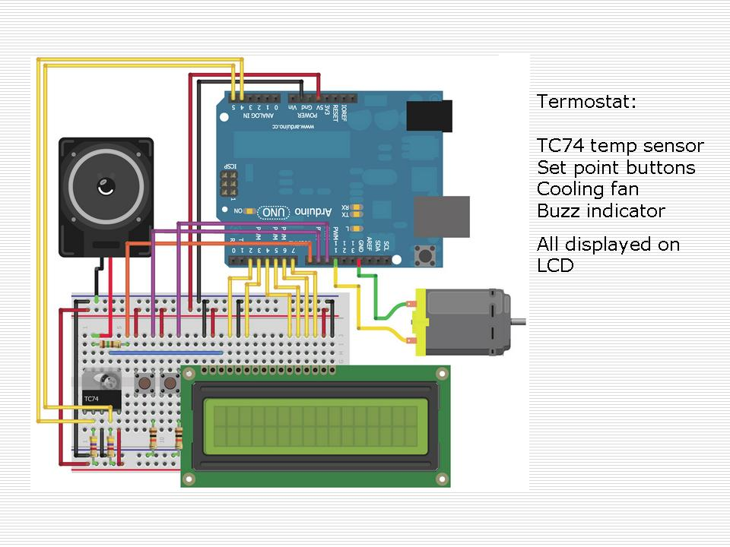

Slide 6
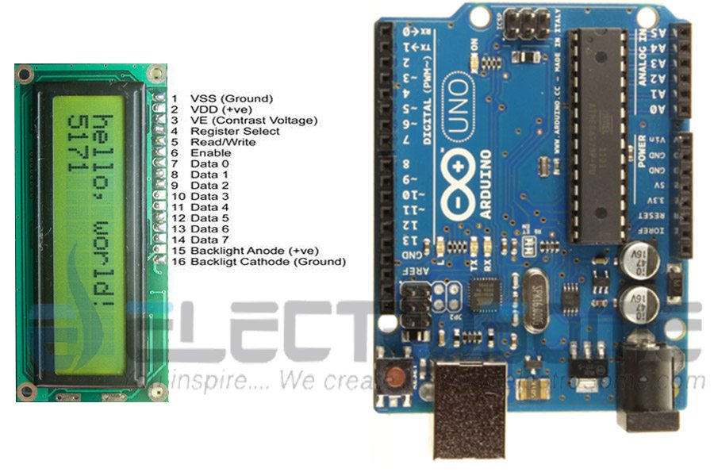

Slide 7
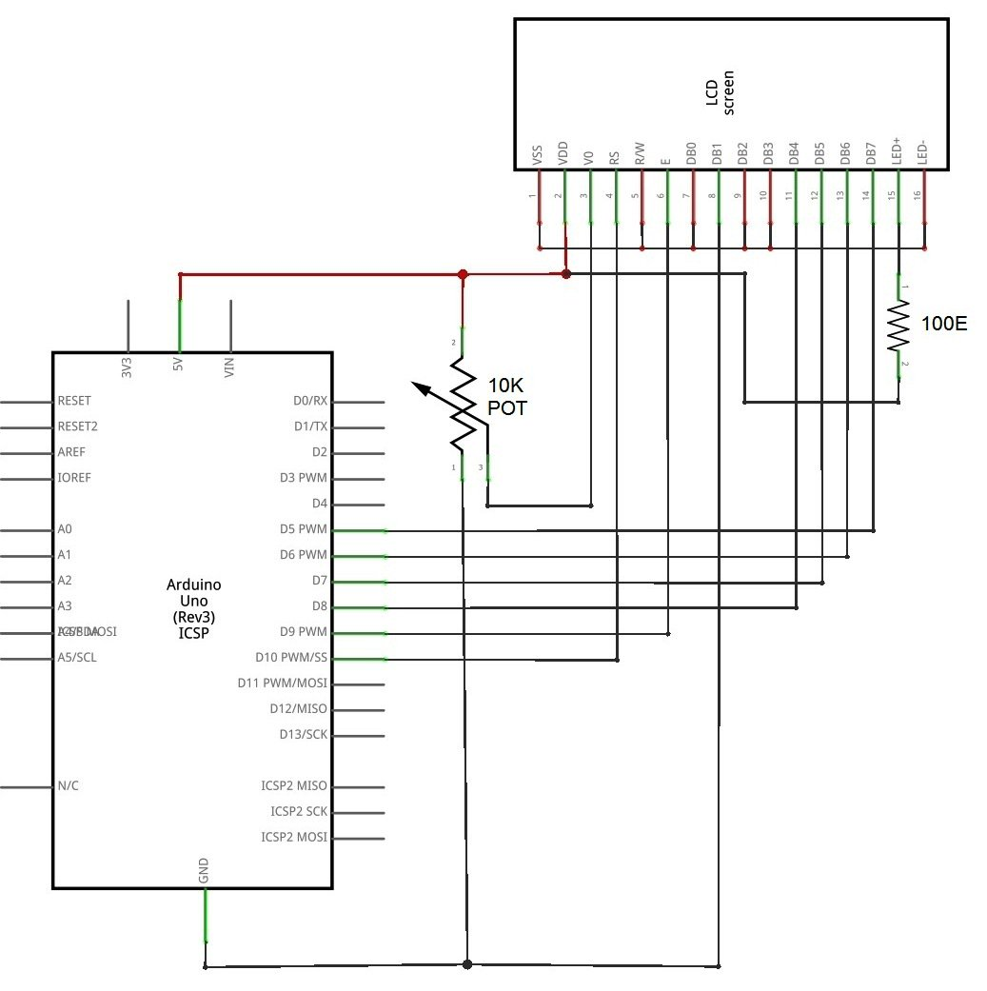

Slide 8
The connections which are done for LCD are given below:
PIN1 or VSS to ground
PIN2 or VDD or VCC to +5v power
PIN3 or VEE to ground (gives maximum contrast best for a beginner)
PIN4 or RS (Register Selection) to PIN0 of ARDUINO UNO
PIN5 or RW (Read/Write) to ground (puts LCD in read mode eases the communication for user)
PIN6 or E (Enable) to PIN1 of ARDUINO UNO
PIN11 or D4 to PIN8 of ARDUINO UNO
PIN12 or D5 to PIN9 of ARDUINO UNO
PIN13 or D6 to PIN10 of ARDUINO UNO
PIN14 or D7 to PIN11 of ARDUINO UNO

